Slide 1
Tales of the Tail:
Hardware, OS, and Application-level Sources of Tail Latency
Jialin Li, Naveen Kr. Sharma, Dan R. K. Ports, and Steven D. Gribble
present by Xinyue Wu
Fresh business general template
Applicable to enterprise introduction, summary report, sales marketing, chart data

Slide 2
Overview
MOTIVATION: Tail latency is problematic.
TARGET: Explore and eliminate the sources of tail latency in network services.
HOWTO:
Establish model to predict ideal tail latency.
Analyze the causes of gap between server's real tail latency and ideal tail latency, and find ways to fix them.

Slide 3
Predict Ideal Tail Latency
PROBLEM: What is the best possible tail latency achievable by a network server?
INSIGHT:Tail latency is not uniform. A burst of requests temporarily exceed the server's capability can cause queuing delays.
SOLUTION:
Establish queuing models to predict latency distributions under different workloads.
Feed real network servers into queuing models.

Slide 4
Queuing Models
Request processing time
Request distribution
Number of workers
Workers(processors, threads, or processes)
Request
Queue

Slide 5
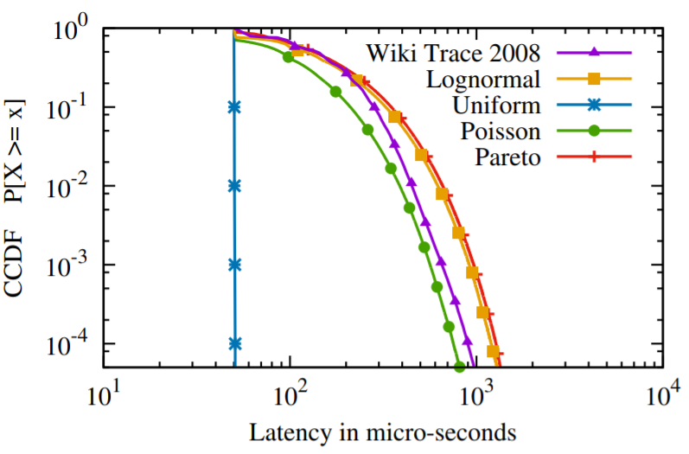
Latency Characteristics Under Different Workloads
Arrival distributions
50µs request processing time
70% average utilization
1 Worker(CPU)

Slide 6
Latency Characteristics Under Different Workloads
Arrival distributions
50µs request processing time
70% average utilization
1 Worker(CPU)
Latency tails exists for workloads that have variable request inter-arrival times.

Slide 7
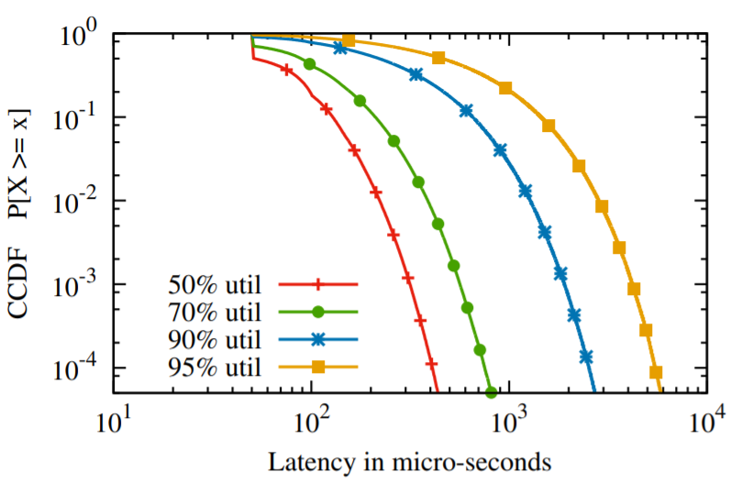
Latency Characteristics Under Different Workloads
Utilization
50µs request processing time
Poisson arrival distribution
1 Worker(CPU)

Slide 8
Latency Characteristics Under Different Workloads
Utilization
50µs request processing time
Poisson arrival distribution
1 Worker(CPU)
Higher utilization, larger tail latency.

Slide 9
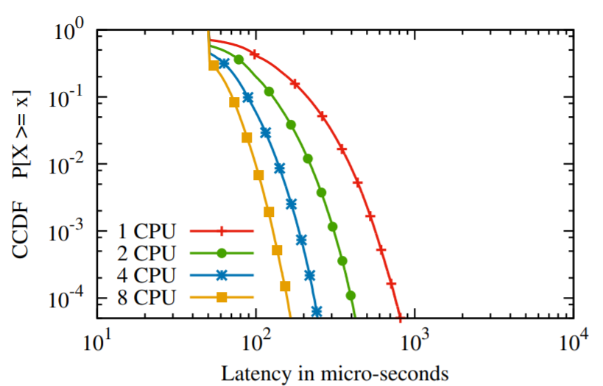
Latency Characteristics Under Different Workloads
Parallel servers feeding from one queue
50µs request processing time
Poisson arrival distribution
70% average utilization

Slide 10
Latency Characteristics Under Different Workloads
Parallel servers feeding from one queue
50µs request processing time
Poisson arrival distribution
70% average utilization
More workers, lower tail latency.

Slide 11
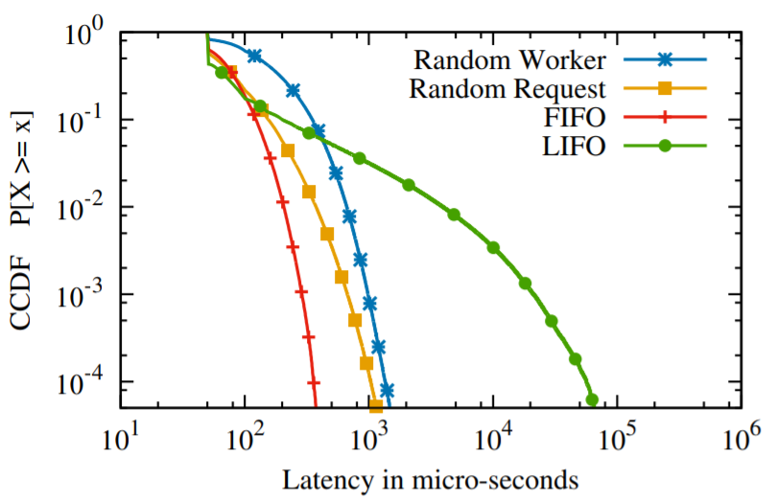
Latency Characteristics Under Different Workloads
Queuing discipline
50µs request processing time
Poisson arrival distribution
80% average utilization
4 workers(CPUs)

Slide 12
Latency Characteristics Under Different Workloads
Queuing discipline
50µs request processing time
Poisson arrival distribution
80% average utilization
4 workers(CPUs)
FIFO scheduling provides the lowest tail latency.

Slide 13
Observations of Queuing Models
Latency tails exist for workloads that have variable request inter-arrival times.
Higher utilization, larger tail latency.
More workers, lower tail latency.
FIFO scheduling provides the lowest tail latency.

Slide 14
Feed Real Network Servers Into Queuing Models
Measure request processing time for queuing model: Run the server on a single core at 100% utilization and mesure the throughput.
e.g., a network server's peak throughput is 125,000 requests per second per core, then the average request processing time is 8µs.
Same request arrival distribution and number of workers for queuing models and real network servers.

Slide 15
Network Servers Chosen for Measurement
Null RPC server
Memcached
Nginx

Slide 16
Null RPC Server
Multi-threaded architecture: blocking
Request queuing and scheduling are manager by the OS
Main accept thread
Fork for new connection
Threads blocking on reading
OS
Request
Schedule

Slide 17
Memcached
Event-driven architecture: non-blocking
TCP mode: connections are partitioned among threads
UDP mode: threads get messages from kernel's receive queue in FIFO order
Connection 1, 2
Receive queue
Connection 3, 4
FIFO order
TCP mode
UDP mode

Slide 18
Sources of Tail Latency
CONFIGURATION: Single CPU, single core, 80% utilization
SOURCE: Contend with background processes
APPROACHS:
Higher priority -> longer time-slices
Realtime priority -> can preempt normal-priority process
Dedicated core -> avoid context switching overhead

Slide 19
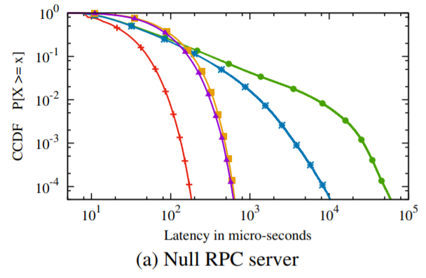
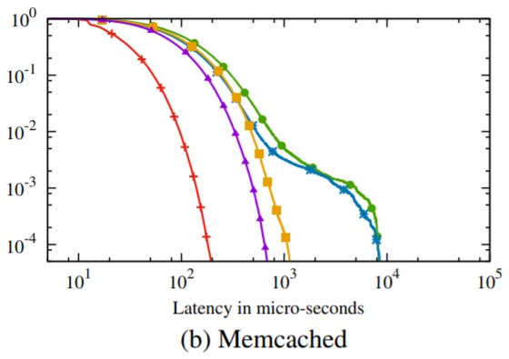
Background processes

Slide 20
Sources of Tail Latency
CONFIGURATION: Single CPU, single core, 80% utilization
SOURCE: Threads are scheduled out of order by
Linux scheduler(Completely Fair Scheduler by default)
APPROACH: Realtime scheduler -> FIFO ordering

Slide 21
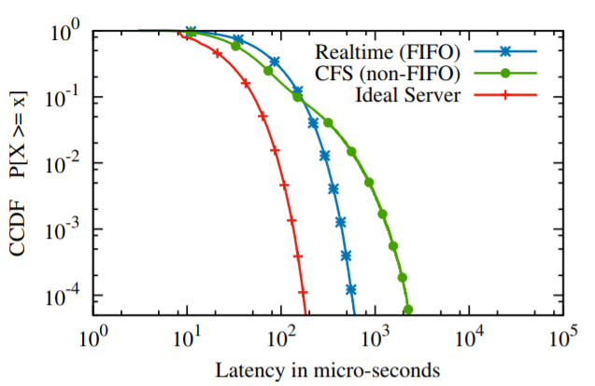
Non-FIFO Scheduling
Null RPC server

Slide 22
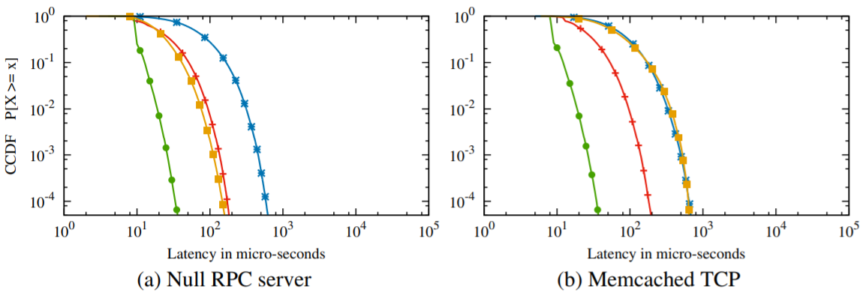
Sources of Tail Latency
CONFIGURATION: single CPU, multi-core, 80% utilization

Slide 23
Sources of Tail Latency
CONFIGURATION: Single CPU, multi-core, 80% utilization
SOURCE: Static partitioning of TCP connections violating the single-queue property.
APPROACH: Change the concurrency architecture to follow a single-queue model. (For memcached, turn from TCP mode to UDP mode)

Slide 24
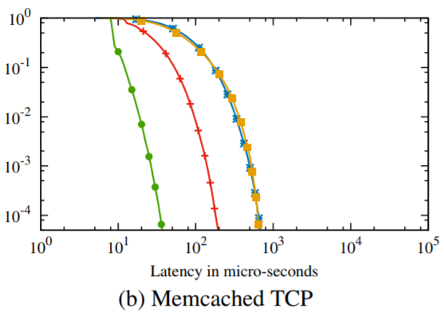
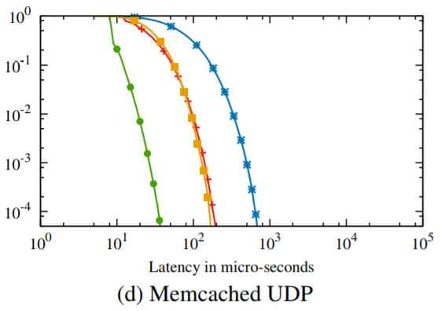
Concurrency Architecture

Slide 25
Sources of Tail Latency
CONFIGURATION: Single CPU, 4 cores, 80% utilization
SOURCE: Application threads are interrupted frequently by incoming packets on all cores
APPROACH: Dedicate a single core for interrupt processing
-> worker threads are not preempted by interrupts

Slide 26
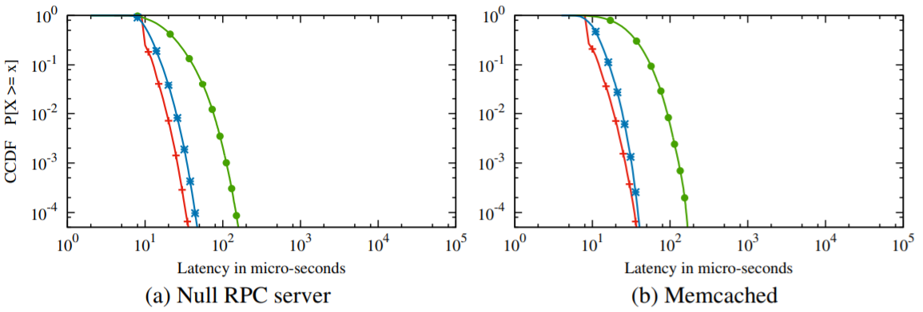
Interrupt Processing

Slide 27
Sources of Tail Latency
CONFIGURATION: 2 CPU, 8 cores, 80% utilization
SOURCE: Cross-NUMA-node memory accesses
APPROACH: One server instance per NUMA node -> Avoid cross-NUMA-node memory accesses

Slide 28
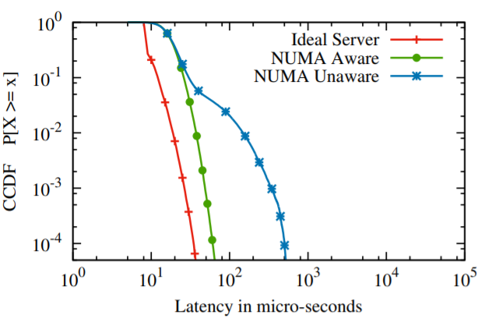
NUMA Effects
Memcached

Slide 29
Sources of Tail Latency
CONFIGURATION: 10% utilization
SOURCE: Power saving mechanisms (idle states & dynamic frequency scaling)
APPROACH: Turn off idle states & dynamic frequency scaling

Slide 30
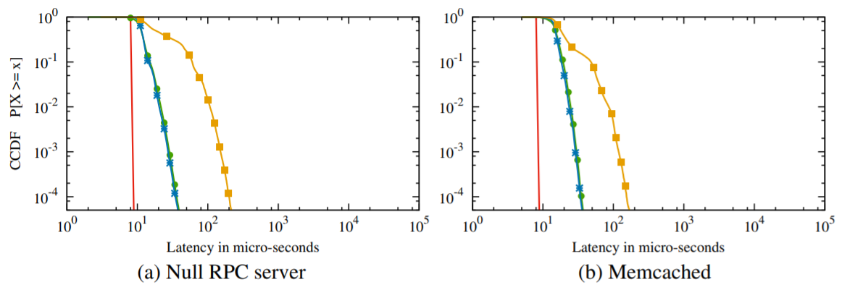
Power Saving Mechanisms

Slide 31
Sources of Tail Latency
Single CPU, single core
Background processes
Non-FIFO scheduling
Concurrency architecture
Interrupt processing
NUMA effects
Power saving mechanisms
Trade-offs exist...
Configuration complexity
Multi-CPU,
multi-core

Slide 32
Conclusion
Characterize the ideal latency distribution of a network service
Identify and quantify the major sources of tail latency
Evaluate possible approaches to eliminate tail latency
Predict the ideal performance before refining
Start from a simple configuration, find a problem, evaluate approaches, fix the problem, move towards more complex configuration, find new problem...

Slide 33


